Slide 1
Appointment Reservation
Transcendence is everything

Slide 2
Members
Professor Payman Salek
Amartuvshin Dovaasureu (team leader)
Madhuri Agrawal
Daniel Tewelde
Tuyen Ngo
Tri Nguyen

Slide 3
Agenda
•Project Features
•Technical Usage
•Architecture
•Class Diagram
•ER Diagram
•Sequence Diagram
•Demonstration

Slide 4
Project Features
Book TM Checking Appointment through the system
To manage the appointments of a attendee and consellor
To manage TM Checking Session
Sending email whenever an appointment has booked or canceled
Reminder system will send email 36 hours prior to remind the attendee and counselor

Slide 5
Technical Usage
•Spring Boot
•Spring MVC
•Spring Security
•JMS
•Java Mail
•JPA
•Quart (scheduling)
•MySQL

Slide 6
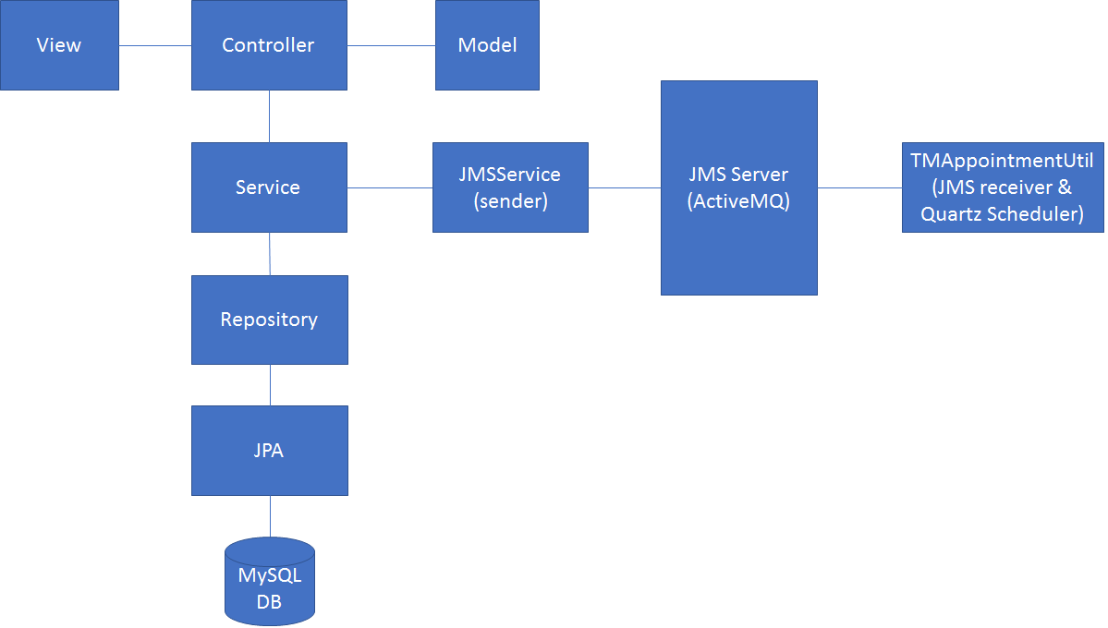
Architecture

Slide 7
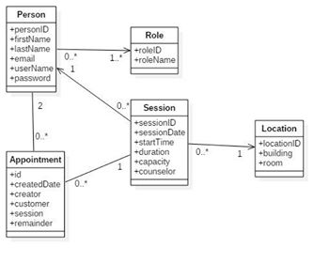
Class Diagram

Slide 8
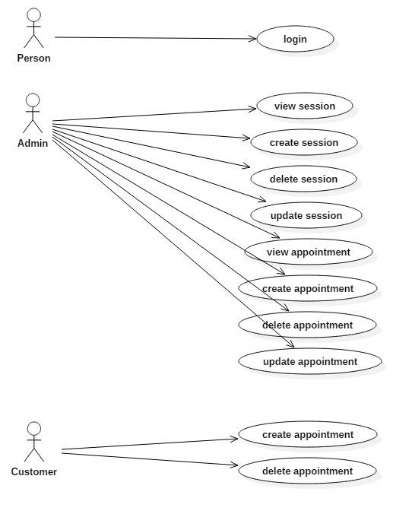
Use Case Diagram

Slide 9
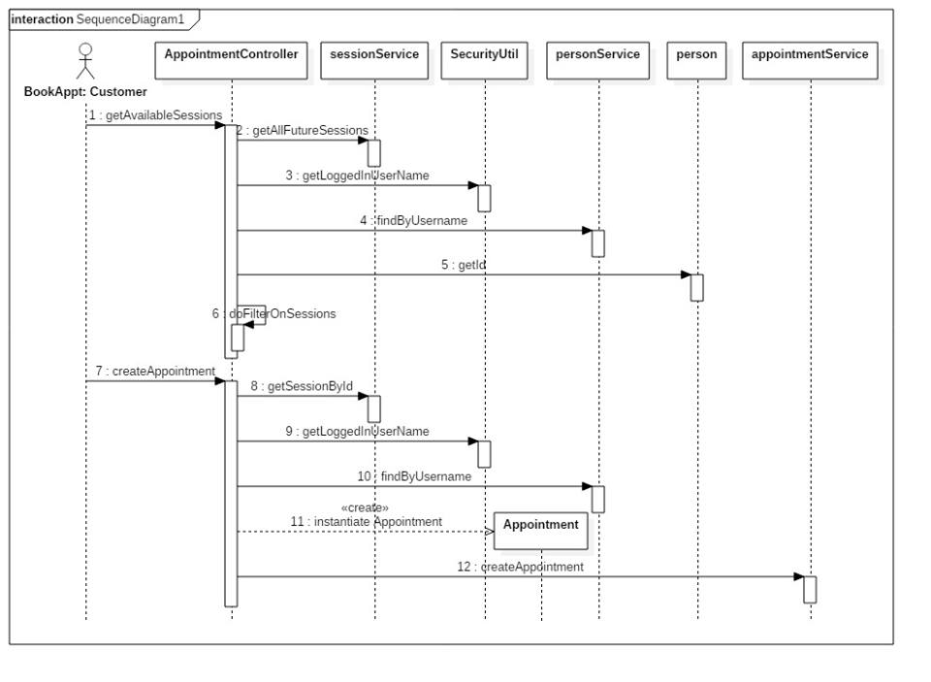
Sequence Diagram for Appointment

Slide 10

Demostration

Slide 11

“Capture the highest fort first”
- From Maharishi

Slide 12
Future Enhancements
Counselor can have more functionalities to perform(create session of own)
Application can be made more user friendly
User Management can be extended

Slide 13
Thank You

